Slide 1

Chit-Chat in Lab (CCL)
Sangeeta Biswas
Lecturer, Dept., of CSE,
University of Rajshahi

Slide 2
Computer Network
[1]
A computer network is a group of computer systems and other computing hardware devices that are linked together through communication channels to facilitate communication and resource-sharing among a wide range of users.
Networks are used to:
Facilitate communication via email, video conferencing, instant messaging, etc.
Enable multiple users to share a single hardware device like a printer or scanner
Enable file sharing across the network
Allow for the sharing of software or operating programs on remote systems
Make information easier to access and maintain among network users

Slide 3

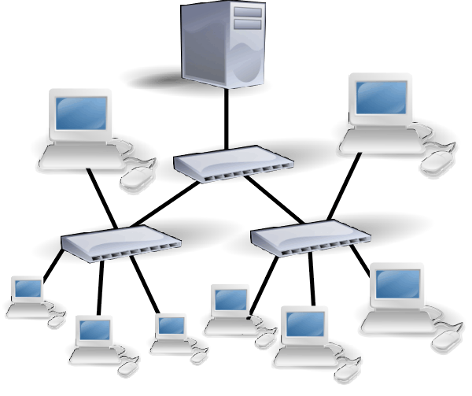
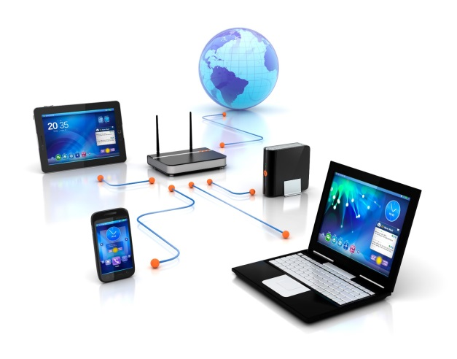
Different Kinds of Network
[1]
There are many types of networks, including:
Local Area Networks (LAN)
Personal Area Networks (PAN)
Home Area Networks (HAN)
Wide Area Networks (WAN)
Campus Networks
Metropolitan Area Networks (MAN)
Enterprise Private Networks
Internetworks (internet)
Backbone Networks (BBN)
Global Area Networks (GAN)
The Internet
(a) Simplest Network
[2]
(b) A bit Complicated Network
[3]
(c) Complicated Network

Slide 4
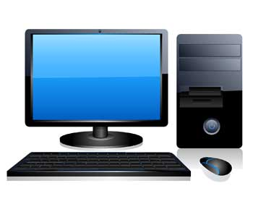
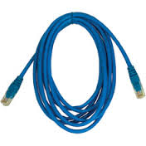
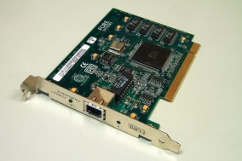
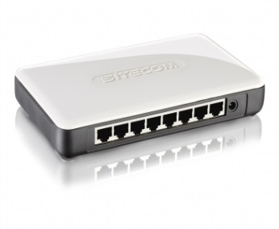
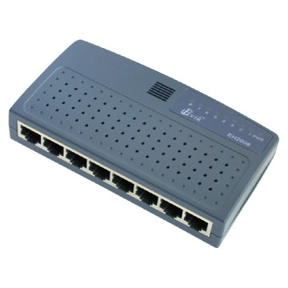
Hardwares of a Network
Computing Hardware Devices
Computer, Printer, Scanner
Communication Channels
Copper straight-through cable, Copper cross-over cable, optical fiber, Wireless channel
Network Interface Card
Connecting Points or Ports
Physical port, logical port
Inter-Connecting devices
Repeater, Hub, Switch, Bridge, Router
PC
Copper Cable
NIC
Hub
Switch
Physical port

Slide 5
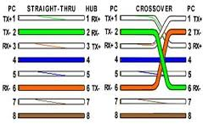
Connection: Straight-Through vs. Cross-Over
*** In Cross-over connection, only (1&3) and (2&6) are crossed

Slide 6
End-points: Straight-Through vs. Cross-Over
Straight-Through (Different type of devices)
PC-to-Hub
PC-to-Switch
Switch-to-Router
Hub-to-Router
PC-to-Router
Hub-to-Switch
Copper Cross-Over (Same type of devices)
PC-to-PC
Hub-to-Hub
Switch-to-Switch
Router-to-Router
PC-to-Router
Hub-to-Switch

Slide 7
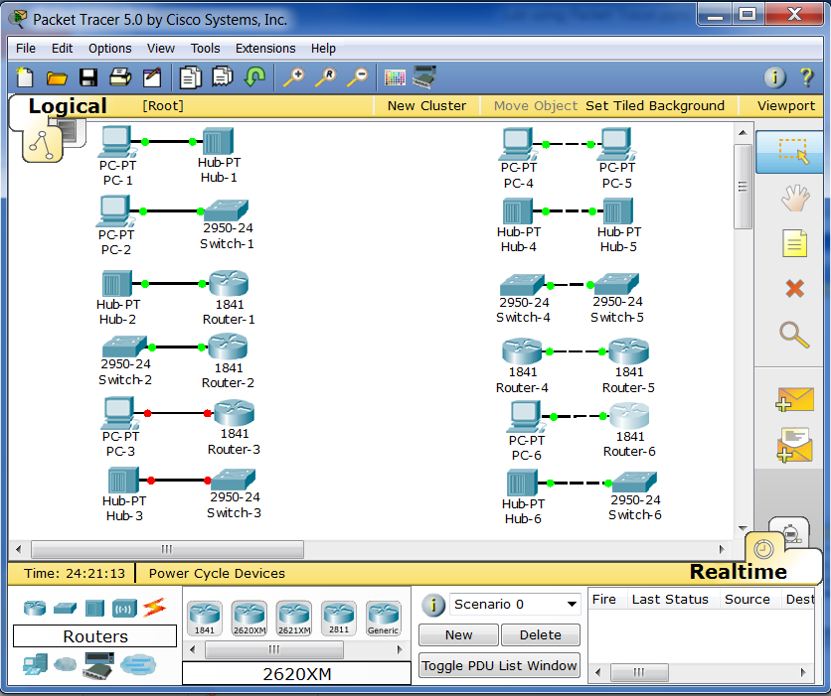
Coper Straight-Through Vs. Cross-Over

Slide 8
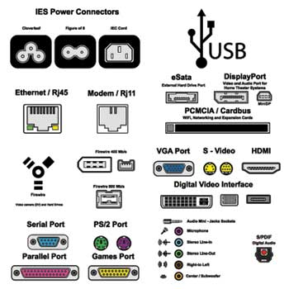
Port
In computer networking ‘port’ refers to connection points.
There are two kinds of ports
Physical port
Logical port
Physical Port:
an interface on a device into which user can insert a connector for that device
Different kind of Physical Ports

Slide 9
Logical Port
A port is an end-point of a logical connection and the way where a client program specifies a particular server program on a computer in a network.
It is always associated with an IP address of a host and the protocol type of the communication.
A logical port number is 16-bit long.
There are 0-65535 logical port numbers.
0-1024 numbers are used for well-known services.
Well-known port numbers are assigned by IANA.
Some well-known ports
20 → FTP data 21 → FTP control
53 → DNS service 80 → HTTP
546 → DHCP Client 547 → DHCP Server

Slide 10

NIC
NIC: Network Interface Controller
It connects a device to a computer network
A device, e.g., a computer must have an NIC in order to connect to a network
It is also known as
Network Interface Card
Network Adapter
LAN Adapter
Physical Network Interface
Common manufacturers:
Intel, Realtek, Broadcom, Qlogic, Group,
An ATM NIC
[Physical Port]

Slide 11
NIC Address
In order to communicate with other devices, each NIC needs two kinds of addresses
Physical Address
Logical Address
Physical Address
One NIC can have only one Physical address
This is a lifetime address
MAC Address
Logical Address
One NIC may have multiple logical address at the same time (rare use)
This is changeable by Administrator or OS or DHCP server
IP Address

Slide 12
MAC Address
MAC: Medium Access Control
Each NIC has a unique physical address known as MAC address.
It is 48 bit long written in either of these formats:
MM:MM:MM:SS:SS:SS
MM-MM-MM-SS-SS-SS
It is assigned by the manufacturer of NIC
Inside a read-only memory
firmware
*OUI: Organizationally Unique Identifier
OUI
NIC specific

Slide 13
How to Know MAC Address
In Windows OS
Go to the Command prompt
Click on Start button, select Run
Type ‘cmd’ and press ENTER
In the Command prompt, type ipconfig /all and press ENTER
In Linux OS
Go to a terminal
In the terminal, type ifconfig and press ENTER

Slide 14
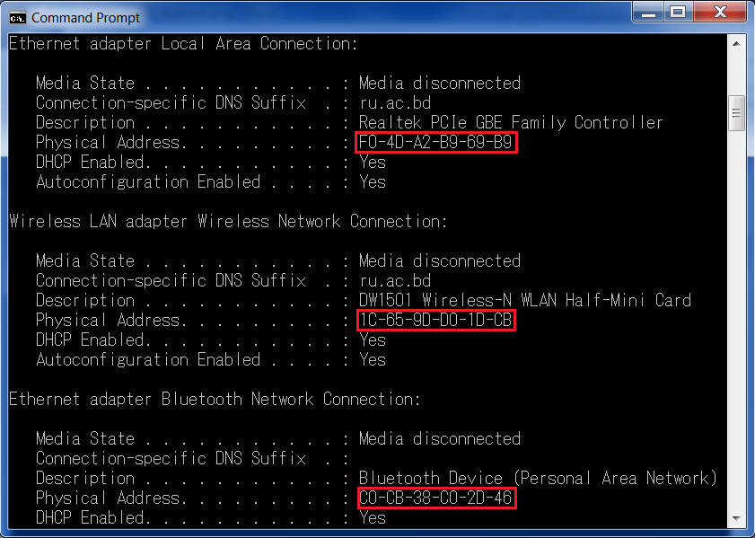
Example: A Laptop having 3 MAC Addresses

Slide 15
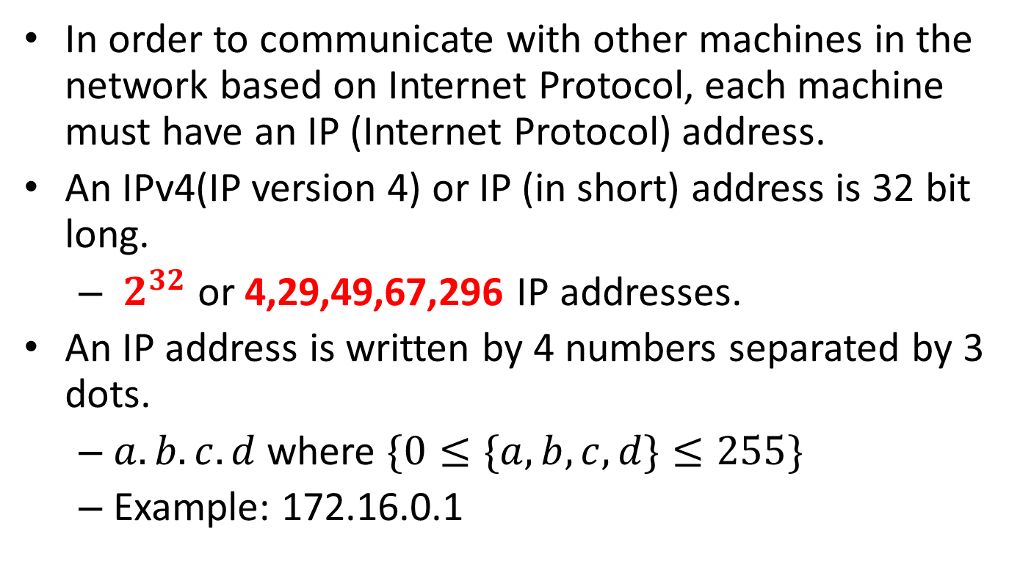
IP Address
In order to communicate with other machines in the network based on Internet Protocol, each machine must have an IP (Internet Protocol) address.
An IPv4(IP version 4) or IP (in short) address is 32 bit long.
$2^{32}$ or 4,29,49,67,296 IP addresses.
An IP address is written by 4 numbers separated by 3 dots.
$a.b.c.d$ where $\{0≤\{a,b,c,d\}≤255\}$
Example: 172.16.0.1

Slide 16
How to Know IP Address
In Command Prompt of Windows OS
Type ipconfig/all and Enter
In GUI of Windows OS
Go to ‘Control Panel’
Click on ‘Network and Internet→ View network status and tasks’
Click on ‘Connections: ’
Click on ‘Details’ Tab
In Linux
Open a terminal
Type ‘ip addr show’ to see all IP addresses
Type ‘ip addr show eth0’ to see IP information about eth0

Slide 17
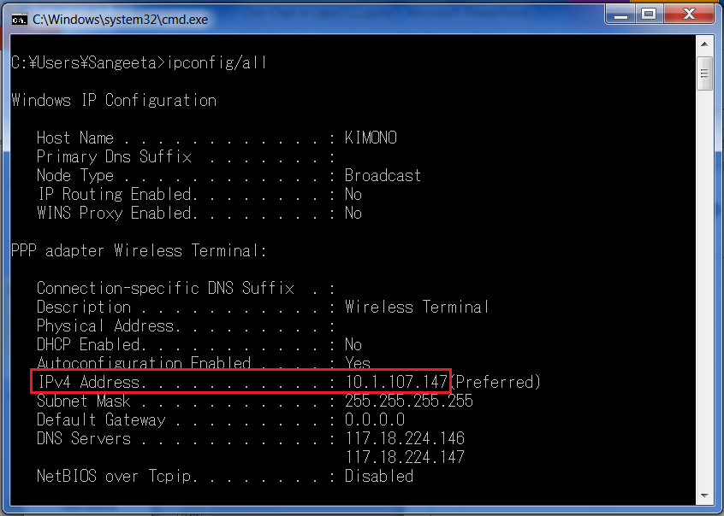
Example: IP Address in Command Prompt

Slide 18
Setting IP Address
An IP address can be assigned to a device by
Root User/ Network Administrator
Operating system
DHCP server
Depending on how frequently an IP address is assigned to a device, there are two kinds of IP addresses
Static : It is not changed as long as network administrator or root user do not change it
Dynamic : It is changed by either operating system or a DHCP server because of disconnection or lease time expiration.

Slide 19
Static vs Dynamic IP Address
Dynamic IP Addresses:
They can be changed each time a user connects to the Internet
Residential Internet connections, whether broadband or dialup usually use dynamic IP addresses.
The need for dynamic IP addresses arises from the limited number of 32bit IP (IPv4) addresses are not sufficient
Static IP Addresses:
They are reserved for a user statically and does not be changed over time.
Commercial leased lines and servers have static IPs, so they can always be reached at the same address.
Every device will have static address when 128 bit IP address (IPv6) will be widely implemented.
A user needs to pay more for a static real IP address than a dynamic real IP address.

Slide 20
Parts of IP Address
An IP address does not actually refer to a device. It refers to a network interface.
If a device, e.g., router, is on two networks, it must have two IP addresses.
An IP address has two parts
Network ID
Host ID
There are two ways to decide the boundary of each part:
Classful Addressing
Classless InterDomain Routing (CIDR)
32 bit IP
Network ID
Host ID

Slide 21
Classful Addressing
For several decades, IP addresses were divided into 5 classes
Class A, B, C, D and E
Class A: 128 networks with 16 million hosts
Class B: 16,384 networks with up to 64,000 hosts
Class C: 2 million networks with p to 256 hosts
This concept is no longer used, only found in literature, because
The number of networks connected to the Internet is growing every year. Classful addressing cannot support this growth.

Slide 22
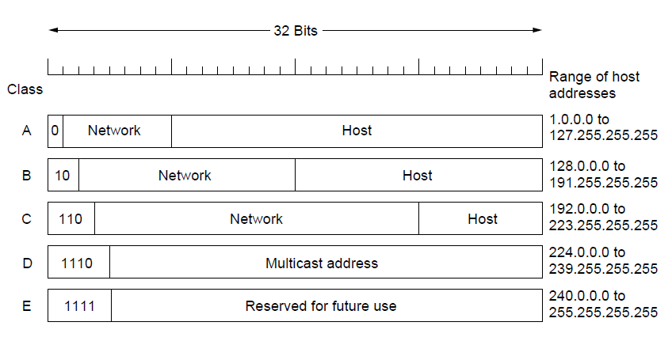
IP Address Range in Classful Addressing

Slide 23
Subnetting
The practice of dividing a network into two or more networks is called subnetting.
A subnetwork (in short ‘subnet’) is a subdivision of a network
For example, a campus network having a Class B address 172.16.0.0/16 can be divided into multiple subnets so that each department can have separate networks [as shown in next page].
32 bit IP
Network ID
Host ID
Network ID
Subnet ID
Host ID

Slide 24
Example of Subnetting
[ A Campus Network with Subnets ]
172.16.1.0 - 172.16.1.255
172.16.5.0 - 172.16.5.255
172.16.2.0 - 172.16.2.255
172.16.6.0 - 172.16.6.255
172.16.3.0 - 172.16.3.255
172.16.7.0 - 172.16.7.255
172.16.4.0 - 172.16.4.255
172.16.8.0 - 172.16.8.255

Slide 25
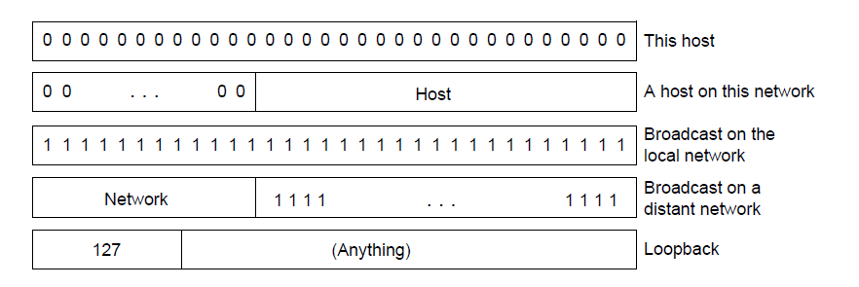
Special IP Address

Slide 26
Private Vs Public IP Address
Uniqueness:
Private IP addresses could be duplicate in different home/office/enterprise networks, e.g., LAN, as long as they are not interconnected.
Public IP addresses cannot be duplicate. In order to communicate on Internet, each machine must have a unique global/public/real IP address.
Responsible:
Network administrator is responsible for deciding private IP addresses for a private network
IANA and 5 RIRs(APNIC, AfriNIC, ARIN, LACNIC & RIPE NCC) are responsible for managing real IP addresses.

Slide 27
Range of Private IP Addresses
Private IP assigned by network administrator:
10.0.0.0 - 10.255.255.255
172.16.0.0 - 172.31.255.255
192.168.0.0 - 192.168.255.255
Private IP assigned by Operating System
169.254.0.0 -169.254.255.255
It is enabled by default in Microsoft Windows OS.
It could occur on a network
without a DHCP server, or
if a DHCP server is temporarily down for maintenance

Slide 28
Authority for Managing IP
IANA: Internet Assigned Numbers Authority
IANA is responsible for the global coordination of
the DNS Root,
Internet number
other Internet protocol resources.
Internet number resources include:
IP addresses
autonomous system (AS) numbers
RIR: Regional Internet Registry
RIR is an organization that manages the allocation and registration of Internet number resources (e.g., IP addresses) within a particular region of the world.

Slide 29
Division of World into RIRs
AfriNIC (African Network Information Centre ): Africa
ARIN (American Registry for Internet Numbers ): the United States, Canada, several parts of the Caribbean region, and Antarctica.
APNIC (Asia-Pacific Network Information Centre): Asia, Australia, New Zealand, and neighboring countries
LACNIC (Latin America and Caribbean Network Information Centre): Latin America and parts of the Caribbean region
RIPE NCC(Réseaux IP Européens Network Coordination Centre): Europe, Russia, the Middle East, and Central Asia

Slide 30
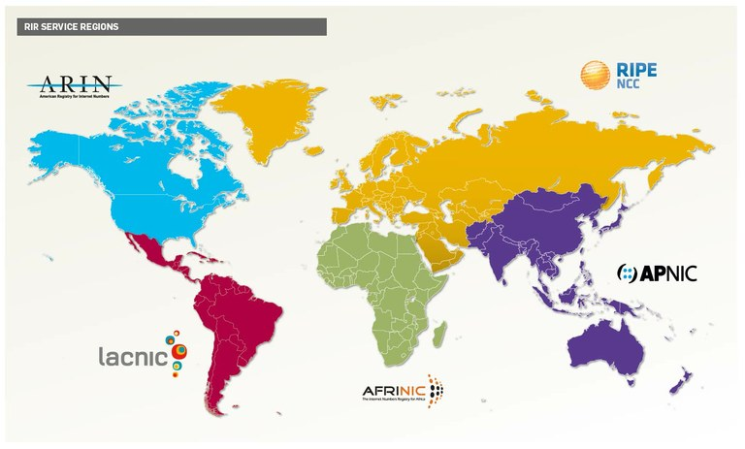
Fig: Service regions of five RIRs nowadays

Slide 31
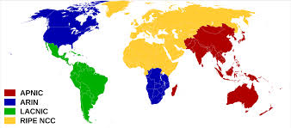
Fig: Service regions of three RIRs in 2002-2005

Slide 32
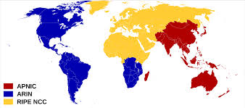
Fig: Service regions of three RIRs in 2002

Slide 33
APNIC
Founded: 13 January, 1993
Focus:
allocating IPv4 and IPv6 address space, and Autonomous System Numbers,
maintaining the public Whois Database for the Asia Pacific region,
representing the interests of the Asia Pacific Internet community on the global stage.
Location: Brisbane, Queensland, Australia
Website: www.apnic.net
Members: 4,737 from 56 economies
Bangladesh has 207 members of APNIC [checked on 20.3.2015]

Slide 34
Membership Tier
APNIC's membership structure is divided into seven tiers.
Membership tier | IPv4 prefix | IPv6 prefix
Associate | None | None
Very small | Up to and including /22 | Up to and including /35
Small | Greater than /22, up to and including /19 | Greater than /35, up to and including /32
Medium | Greater than /19, up to and including /16 | Greater than /32, up to and including /29
Large | Greater than /16, up to and including /13 | Greater than /29, up to and including /26
Very large | Greater than /13, up to and including /10 | Greater than /26, up to and including /23
Extra large | >/10 | >/23

Slide 35
APNIC’s BD Members [checked on 20.3.2015]
207 members, e.g.,
Tier: rank/one of several layers or levels
Member | Membership Tier
Bangladesh Computer Council | Associate
Apple Network Ltd. | Very Small
Banglalink GSM | Small
Grameenphone limited | Small
Bangladesh Telegraph & Telephone Board | Medium
Banglalion Communication Ltd. | Medium
Augere Wireless Broadband Bangladesh Limited | Large
Mango Teleservices Limited. | Large

Slide 36
APNIC Whois Search(1)
http://wq.apnic.net/whois-search/static/search.html
inetnum: | 180.211.128.0 - 180.211.255.255
netname: | BTTB-BD
descr: | Bangladesh Telegraph & Telephone Board
country: | BD
128 × 256 = 32,768 IP addresses
*** RU rent 32 IP addresses
inetnum: | 117.18.224.0 - 117.18.231.255
netname: | citycell
descr: | service provider
country: | BD
8 × 256 = 2,048 IP addresses

Slide 37
APNIC Whois Search(2)
http://wq.apnic.net/whois-search/static/search.html
inetnum: | 114.130.0.0 - 114.130.255.255
netname: | MANGOTELESERVICE-BD
descr: | Mango Teleservices, IIG of Bangladesh
country: | BD
256 × 256 = 65,536 IP addresses
inetnum: | 202.56.4.0 - 202.56.7.255
netname: | GRAMEENPHONEIT
descr: | Grameenphone is the largest telecommunication Organisation
country: | BD
4 × 256 = 1,024 IP addresses

Slide 38
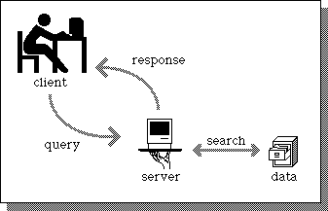
Server
A server is a computer program that provides services to other computer programs (and their users) in the same or other computers.
The device that a server program runs in is also frequently referred to as a server.
In the client/server programming model:
a server is a program that awaits and fulfills requests from client programs
a client is a program that requests for services
Some popular servers
DHCP server
DNS server
File server
Mail server
Web server
Proxy server
Database server
Printer server
A typical server-client model [14]
Step-3
Step-1
Step-2

Slide 39
DHCP
DHCP : Dynamic Host Configuration Protocol
It is a protocol used to automatically/dynamically provide network configuration information to devices connected to an IP network.
DHCP usually provides:
IP Address
Subnet mask
Gateway address
Name server address

Slide 40
Advantages of DHCP(1)
Reduced time to configure and deploy: When the number of hosts is large in a network, DHCP is faster than human engineer especially than inexperienced/ non-technical administrator to allocate unique IP addresses.
Reliable IP address configuration: DHCP minimizes configuration errors caused by manual IP address configuration, such as typographical errors, or address conflicts caused by the assignment of an IP address to more than one computer at the same time.

Slide 41
Advantages of DHCP(2)
Reduced network administration: DHCP includes features to efficiently handle the IP address changes for clients that must be updated frequently, such as those for portable computers that move to different locations on a wireless network. This feature reduces operational overhead of network administrator.
Centralized management: The DHCP Server maintains configurations for several networks. Therefore, an administrator only needs to update a single, central server when configuration parameters change.

Slide 42
Advantages of DHCP(3)
Reduced costs:
Using automatic IP address assignment at each remote site substantially reduces Internet access costs. Static IP addresses are considerably more expensive to purchase than are automatically allocated IP addresses.
Because DHCP is easy to configure, it minimizes costs associated with device configuration tasks and eases deployment by nontechnical users.

Slide 43
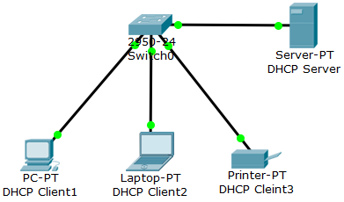
DHCP Server-Client Model
DHCP is based on a server-client model.
DHCP Server: maintains TCP/IP configuration information and provide address configuration to DHCP-enabled clients in the form of a lease offer.
DHCP Client: obtains an IP address from a DHCP Server dynamically using the DHCP protocol.

Slide 44
DHCP Address Pool
Address pool is a set of IP addresses decided by a Network engineer for allocating to DHCP clients by the DHCP server.
The nature of IP addresses received by DHCP clients will depend on the nature of IP addresses in the pool.
For example, if 192.167.23.0 255.255.255.0 is assigned to a pool, DHCP clients will dynamically get 254 real IP addresses in the range 192.167.23.1-192.167.23.254.
On the other hand, if 192.168.23.0 255.255.255.0 is assigned to a pool, DHCP clients will dynamically get 254 private IP addresses in the range 192.168.23.1-192.168.23.254.

Slide 45
Allocation of IP Addresses
Based on availability and usage policies set on the DHCP server, it chooses an appropriate address (if any) from its pool to give to the client.
The DHCP Server pings chosen address a certain times before assigning that address to the requesting client.
If the ping is unanswered, the DHCP Server assumes (with a high probability) that
the address is not in use and
reserves the address to the requesting client.

Slide 46
Steps for Getting an IP Address
When a machine connected in the network is turned on with a DHCP client:
The client sends a broadcast request (called a DISCOVER or DHCPDISCOVER), looking for a DHCP server to answer.
The DHCP server temporarily reserves an IP address for the client and sends back to the client an OFFER (or DHCPOFFER) packet, with that address information.
The client sends a REQUEST (or DHCPREQUEST) packet, letting the server know that it intends to use the address.
The server sends an ACK (or DHCPACK) packet, confirming that the client has a been given a lease on the address for a server-specified period of time.

Slide 47
DORA
DHCP’s steps are abbreviated as DORA
DHCP Client
DHCP Server
1. Discovery (DISCOVER or DHCPDISCOVER)
2. Offer (DHCPOFFER)
3. Request (DHCPREQUEST)
4. Acknowledgement (DHCPACK)

Slide 48
DHCP Relay Agent
Along with the DHCP server and DHCP clients, there is a DHCP relay agent in DHCP.
A DHCP relay agent relays DHCP packets between clients and servers, when they are not on the same physical subnet/ network.
Because DHCP is a broadcast-based protocol, by default its packets do not pass through routers. A DHCP relay agent receives any DHCP broadcasts on the subnet and forwards them to the specified IP address on a different subnet.
Relay agent forwarding is distinct from the normal forwarding of an IP router, where IP datagrams are switched between networks somewhat transparently.

Slide 49
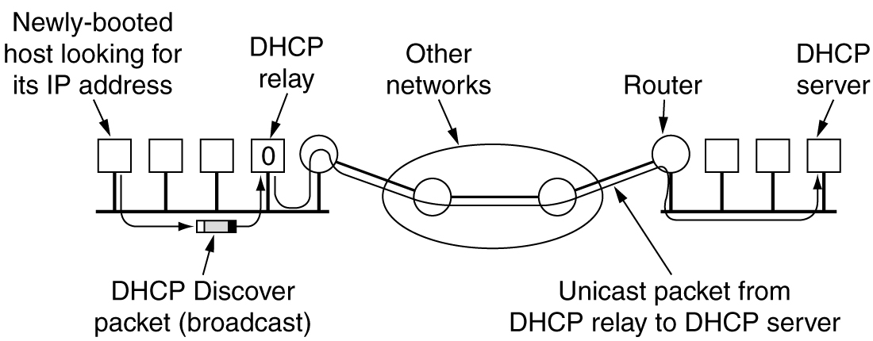
Operation of DHCP Relay Agent
When a relay agent receives DHCP messages, it sets the gateway address (giaddr field of the DHCP packet) and if configured, adds the relay agent information option (option82) in the packet and forwards it to the DHCP server.
The reply from the server is forwarded back to the client after removing option 82.

Slide 50
APIPA
APIPA (Automatic Private IP Addressing) is a mechanism to assign IP addresses dynamically to DHCP clients when DHCP servers are temporarily / permanently unavailable.
It could occur on a network
without a DHCP server, or
if a DHCP server is temporarily down for maintenance
It is enabled by default in Microsoft Windows OS.
IANA has reserved IP addresses from 169.254.0.0 to 169.254.255.255 for APIPA.
A client get an IP address in the range of 169.254.0.1 - 169.254.255.254 by it’s OS
It verifies the uniqueness of IP addresses by ARP

Slide 51
Limited Access
After the network adapter has been assigned an IP address, the computer can use TCP/IP to communicate with any other computer that is:
connected to the same LAN and that is also configured for APIPA or
has the IP address manually set to the 169.254.x.y (where x.y is the client’s unique identifier) address range with a subnet mask of 255.255.0.0.
The computer cannot communicate with
computers on other subnets, or
computers that do not use APIPA, i.e., that got IP addresses from DHCP servers
[[Computer with an APIPA address has ‘Limited Access ’]]

Slide 52
ARP
ARP: Address Resolution Protocol
It is a network layer protocol used to convert network layer addresses (e.g., IPv4 addresses) into MAC address.
In order to send a packet to a machine, a host needs to know the MAC address of destination machine. ARP helps host in such situation.
How does it work:
Host-A wishing to obtain a physical address corresponding to an IP address , asks its ARP program.
The ARP program looks in the ARP table and, if it finds the address, provides it to Host-A.
Otherwise, the ARP program broadcasts an ARP request packet onto the TCP/IP network.
The machine on the network that has the IP address in the request then replies with its physical hardware address to the ARP program of Host-A.
ARP program saves IP address and corresponding IP address in the ARP table of Host-A for future reference.

Slide 53
DHCP Configuration using Packet Tracer 6.1
Recommended PDF :
Chapter : Configuring DHCP
Cisco IOS IP Configuration Guide Release 12.2

Slide 54
Problem-1
Configure a DHCP server for a simple LAN of 8 machines covering four rooms of our CSE department
Rooms: admin, R122, R120 and R119
At most 30 machines can be attached to this LAN
Start IP address: 172.16.0.0
DHCP Server’s IP address: 172.16.0.1
Other machines will get IP addresses from DHCP server when they will be booted. Say if PC-1 of R122 is booted earlier than PC-1 of R119, then R122-PC1 will get lower IP address.

Slide 55
Solution: CSE Network-1
Take one Server and one PC for Admin’s room(say, admin).
For other three rooms (say R122,R120 and R119), take 2 PCs.
Connect all machines to a Switch using Copper Straight-Through connector.
Wait for a while so that all connections will have green boxes indicating that all machines are connected to Switch.
Change name of all machines, eg., R122-PC1, R119-PC1 or NetAdmin-PC, etc. [Figure in next slide]
Assign an static IP, say 172.16.0.1, to DHCP server.
Rest of the 7 machines will get IP addresses dynamically from the server after DHCP server configuration completed.

Slide 56
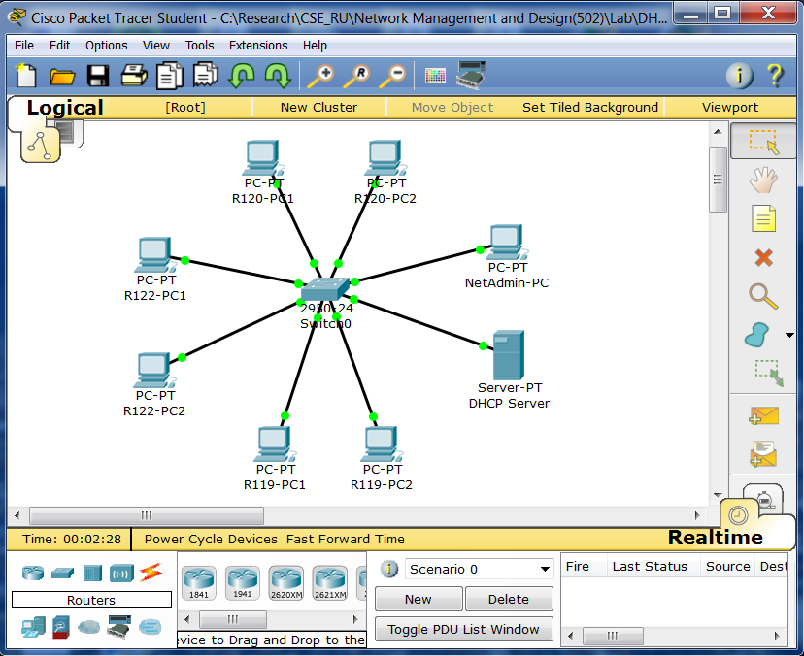
DHCP Server Configured in a Server Machine

Slide 57
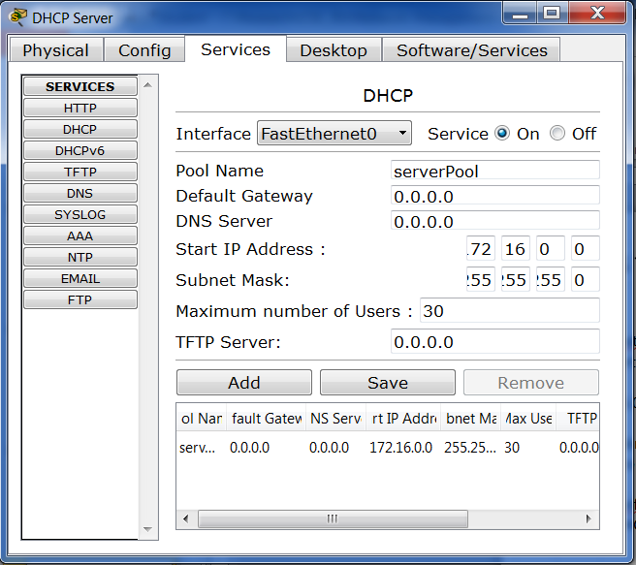
Steps for DHCP Configuration(1)
1. Double click on DHCP server.
2.Open ‘Services‘ window
3. Click on DHCP
4. Click on Service (On) radio button
5. Put 172.16.0.0 into ‘Start IP Address’.
6. Set Subnet Mask 255.255.255.0
7. Put 30 into ‘Maximum number of Users’ box.
8. Click on ‘Save’ button

Slide 58
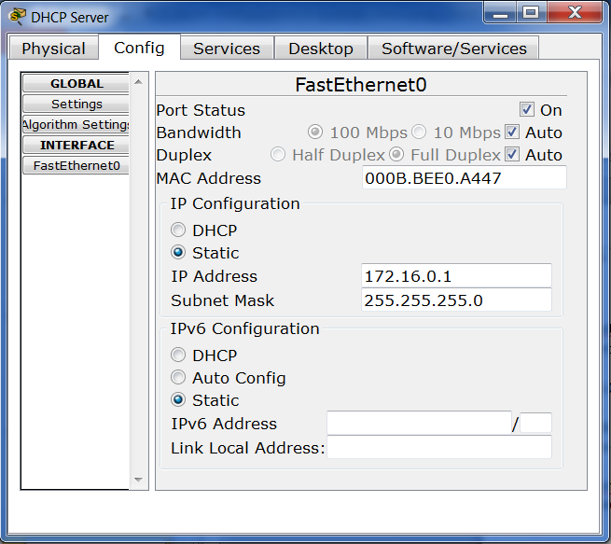
Steps for DHCP Configuration(2)
8. Click on Config-> FastEthernet
9. Ensure ‘Port Status’ is checked.
10. Put 172.16.0.1 into ‘IP Address’.
11. Click on Subnet Mask
(it will be automatically changed)
12. Close ‘Config’ window of DHCP Server.

Slide 59
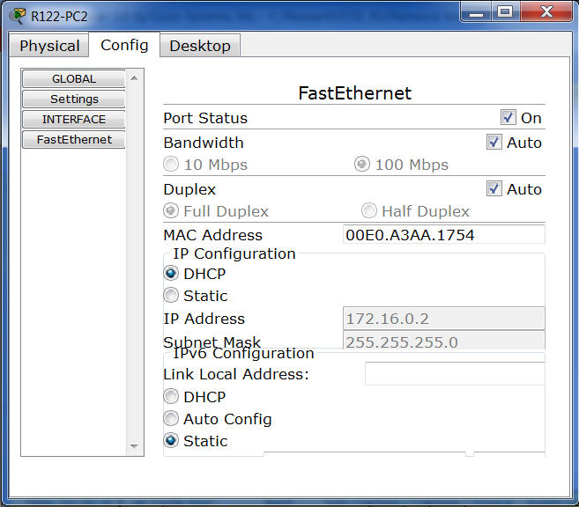
Steps for IP Address Allocation
1. Open ‘Config’ window of a client, e.g., PC.
2. Click on FastEthernet.
3. Ensure ‘Port Status’ is checked.
4. Click on ‘DHCP’ radio button
5. Wait for a while
6. Close ‘Config’ window of PC.

Slide 60
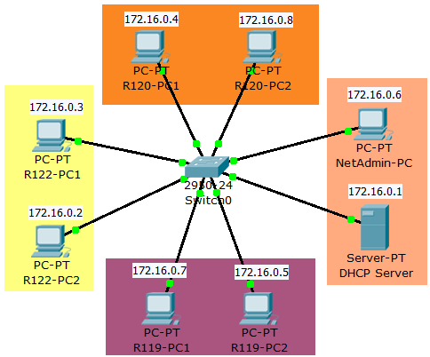
Final Look of CSE Network-1
* PCs of R122 got sequential IP addresses while PCs of other rooms got discontinuous addresses.
* Allocation of IP addresses was dependent on the clients’ booting sequence.

Slide 61
Problem-2
Configure a DHCP server for CSE simple LAN
R122, R120, R119 and admin rooms could have at most 254 machines
Range of IP address:
admin: 172.16.0.1-172.16.0.254
R119 : 172.16.10.1-172.16.10.254
R120 : 172.16.20.1-172.16.20.254
R122 : 172.16.30.1-172.16.30.254
Machines will get IP addresses from DHCP server when they will be booted. Say if PC-1 of R122 is booted earlier than PC-2, R122-PC1 will get lower IP address.

Slide 62
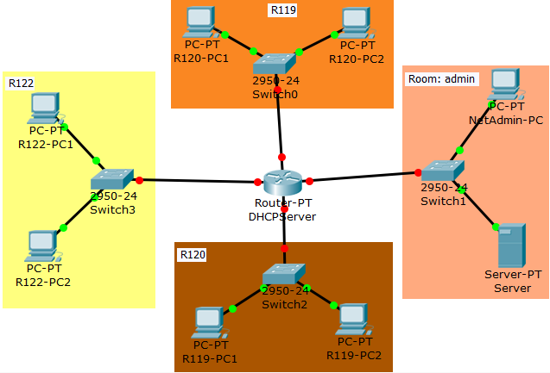
Solution
We need to make four subnets for four rooms.
We need a router to connect four subnets.
We can configure a DHCP server either in the router or in the server machine in the admin room

Slide 63
Few Commands for Configuring a DHCP Server in a Router(1)
Task | Command
See command list | Router>? Router#?
Turn on privileged commands | Router> enable
Enter configuration mode | Router# configure terminal
Select an interface to configure | Router(config)# Interface FastEthernet[number,e.g.,0/1]
Allocate IP address | Router(config-if)# ip address IP-address mask
Turn on port | Router(config-if)# no shutdown
Inform relay agent about DHCP server | Router(config-if)# ip helper-address IP-address
Exit from interface configuration mode | Router(config-if)# exit

Slide 64
Few Commands for Configuring a DHCP Server in a Router(2)
Task | Command
See command list | Router(config)#? Router(dhcp-config)#?
Configure a DHCP Address Pool | Router(config)# ip dhcp pool name
Configure the subnet and mask of the DHCP Address Pool | Router(dhcp-config)# network network-number mask
Set gateway | Router(dhcp-config)# default-router IP-address
Set DNS server | Router(dhcp-config)# dns-server IP-address
Exclude IP addresses | Router(config)# ip dhcp excluded-address low-address [high-address]
Exit from network configuration mode | Router(dhcp-config)# exit

Slide 65
Command: ping
[17]
‘ping’ command is a Command Prompt command.
It is used to test the ability of the source computer to reach a specified destination computer.
It operates by sending Internet Control Message Protocol (ICMP) Echo Request messages to the destination computer and waiting for a response.
It provides following information
how many of those responses are returned, and
how long it takes for them to return
Example:
ping www.mail.yahoo.com
Just type ‘ping’ in the command window of windows machine in order to see other options.

Slide 66
Ping www.mail.yahoo.com [using Wi-Fi of CityCell]
C:\Users\Sangeeta>ping www.mail.yahoo.com
Pinging src.g03.yahoodns.net [106.10.212.150] with 32 bytes of data:
Reply from 106.10.212.150: bytes=32 time=297ms TTL=53
Reply from 106.10.212.150: bytes=32 time=350ms TTL=53
Reply from 106.10.212.150: bytes=32 time=1896ms TTL=53
Reply from 106.10.212.150: bytes=32 time=637ms TTL=53
Ping statistics for 106.10.212.150:
Packets: Sent = 4, Received = 4, Lost = 0 (0% loss),
Approximate round trip times in milli-seconds:
Minimum = 297ms, Maximum = 1896ms, Average = 795ms

Slide 67
Analysis of Previous Output
4 ICMP Echo Requests were sent.
Packet’s size was 32 bytes.
TTL : Time To Live
is a value that tells a network router whether or not the packet has been in the network too long and should be discarded.
The 0% loss reported under Ping statistics for 106.10.212.150 tells that each ICMP Echo Request message sent to www.mail.yahoo.com was returned.
This means that, as far as network connection is Okay, user can communicate with yahoo’s mail server.
By ‘n’ and ‘l’ options user can change default values of packet number and packet’s size.
Example : ping –n 300 –l 1500 www.mail.yahoo.com

Slide 68
Command: tracert
‘tracert’ is a computer network diagnostic tool to:
display the route (path) and
measure transit delays of packets across an IP network.
‘tracert’ sends out three packets per TTL increment. Column 2, 3 and 4 correspond to the round-trip-time of three packets.
* * * means tracert packets have been dropped.
The maximum hop count number can be changed using ‘-h’ option, e.g.,:
tracert –h 34 www.titech.ac.jp
Just type ‘tracert’ in the command window of windows machine in order to see other options.

Slide 69
Route to www.apinc.net [from our Department]
C:\Users\Sangeeta>tracert www.apnic.net
Tracing route to www.apnic.net [203.119.102.244] over a maximum of 30 hops:
1 1 ms 6 ms 4 ms 172.16.0.1
2 <1 ms <1 ms 1 ms 180.211.185.200
3 1 ms 12 ms 1 ms 180.211.183.137
4 2 ms 16 ms 1 ms 180.211.182.73
5 7 ms 9 ms 7 ms 180.211.182.61
6 10 ms 10 ms 15 ms 180.211.130.33
7 5 ms 5 ms 5 ms 180.211.130.6
8 10 ms 10 ms 66 ms 180.211.200.1
9 5 ms 5 ms 5 ms 123.49.13.94
10 221 ms 221 ms 221 ms 103.9.137.237
11 * * * Request timed out.
12 341 ms 341 ms 341 ms 182.79.245.149
13 * * * Request timed out.
14 513 ms 513 ms 513 ms 203-29-129-209.static.tpgi.com.au [203.29.129.209]
15 505 ms 505 ms 505 ms ve2034.rn-639gardeners-cer-01.tpg-telecom.net [203.161.139.241]
16 520 ms 520 ms 520 ms ve2011.rq-127creek-cer-01.tpg-telecom.net [121.101.138.70]
17 506 ms 506 ms 506 ms ip-34-129-161-203.static.pipenetworks.com [203.161.129.34]
18 510 ms 510 ms 510 ms squiz-proxy.apnic.net [203.119.102.244]
Trace complete.

Slide 70
Route to www.apnic.net [using Wi-Fi of CityCell]
C:\Users\Sangeeta>tracert www.apnic.net
Tracing route to www.apnic.net [203.119.102.244] over a maximum of 30 hops:
1 * * * Request timed out.
2 328 ms 179 ms 159 ms 192.168.4.54
3 159 ms 159 ms 460 ms 192.168.101.6
4 279 ms 259 ms 320 ms 85.dhk-peer.mango.com.bd [114.130.3.85]
5 280 ms * 1084 ms 114.130.1.57
6 198 ms 219 ms 199 ms if-3-1-0.core1.CFO-Chennai.as6453.net [116.0.79.45]
7 624 ms 919 ms 539 ms if-0-1-2-0.tcore2.CXR-Chennai.as6453.net [180.87.36.17]
8 440 ms 397 ms 519 ms if-6-2.tcore2.SVW-Singapore.as6453.net [180.87.37.14]
9 1294 ms 505 ms 458 ms if-1-2.tcore1.HK2-Hong-Kong.as6453.net [180.87.112.1]
10 650 ms 767 ms 604 ms 116.0.67.34
11 400 ms 399 ms 398 ms 203-29-129-145.static.tpgi.com.au [203.29.129.145]
12 444 ms 459 ms 699 ms ve2034.rn-639gardeners-cer-01.tpg-telecom.net [203.161.139.241]
13 415 ms 399 ms 674 ms ve2011.rq-127creek-cer-01.tpg-telecom.net [121.101.138.70]
14 676 ms 679 ms 678 ms ip-34-129-161-203.static.pipenetworks.com [203.161.129.34]
15 736 ms 899 ms 719 ms squiz-proxy.apnic.net [203.119.102.244]
Trace complete.

Slide 71
References (1)
http://www.techopedia.com/definition/25597/computer-network
http://www.m2x.eu/
http://www.sinaiinfotech.co.tz/taxonomy/term/12
Andrew S. Tanenbaum, ‘Computer Networks’, Pearson
Wikipedia
http://www.internetassignednumbersauthority.org/
http://en.wikipedia.org/wiki/Regional_Internet_registry
https://www.ripe.net/internet-coordination/internet-governance/internet-technical-community/the-rir-system
www.apnic.net
http://en.wikipedia.org/wiki/Traceroute
http://averma82.blogspot.com/2013/05/what-is-portnumber-logical-port.html
http://en.wikipedia.org/wiki/Dynamic_Host_Configuration_Protocol
https://kb.iu.edu/d/adov

Slide 72
References (2)
http://infomotions.com/musings/waves/clientservercomputing.html
http://www.webopedia.com/TERM/D/DHCP.html
https://technet.microsoft.com/en-us/library/dd145320(v=ws.10).aspx
http://support.microsoft.com/en-us/kb/220874
Chapter: Configuring DHCP, Cisco IOS IP Configuration Guide Release 12.2
http://compnetworking.about.com/cs/protocolsdhcp/g/bldef_apipa.html
http://www.cisco.com/en/US/docs/ios/12_4t/ip_addr/configuration/guide/htdhcpre.html
http://pcsupport.about.com/od/commandlinereference/p/ping-command.htm
http://www.tutorialspoint.com/computer_fundamentals/computer_types.htm

Slide 73
Confession
It is possible that some sentences or some information were included in these slides without mentioning exact references. I am sorry for violating rules of intellectual property. When I will have a bit more time, I will try my best to avoid such things.
These slides are only for students in order to give them very basic concepts about the giant, “Networking”, not for experts.
Since I am not a network expert, these slides could have wrong/inconsistent information…I am sorry for that.
Students are requested to check references and Books, or to talk to Network engineers.

